Slide 1

Lecture 11 and 12
Fundamentals and Applications (CSO201A)
Dr. Srinivas Dharavath
Assistant Professor
Department of Chemistry
Indian Institute of Technology, Kanpur
Kanpur- 208016
E-mail: srinivasd@iitk.ac.in

Slide 2

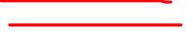
Reaction intermediates

Slide 3

Reaction intermediates
In chemistry, a reactive intermediate or an intermediate is a short-lived, high-energy, highly reactive. When generated in a chemical reaction, it will quickly convert into a more stable molecule. Only in exceptional cases can these compounds be isolated and stored, e.g. low temperatures, matrix isolation. When their existence is indicated, reactive intermediates can help explain how a chemical reaction takes place.
Most chemical reactions take more than one elementary step to complete, and a reactive intermediate is a high-energy, yet stable, product that exists only in one of the intermediate steps. The series of steps together make a reaction mechanism. A reactive intermediate differs from a reactant or product or a simple reaction intermediate only in that it cannot usually be isolated but is sometimes observable only through fast spectroscopic methods. It is stable in the sense that an elementary reaction forms the reactive intermediate and the elementary reaction in the next step is needed to destroy it.
When a reactive intermediate is not observable, its existence must be inferred through experimentation. This usually involves changing reaction conditions such as temperature or concentration and applying the techniques of chemical kinetics, chemical thermodynamics, or spectroscopy. We will often refer to certain reactive intermediates based on carbon, viz., carbocation, radicals, carbanions and carbenes.

Slide 4

Reaction intermediates
The Main carbon and nitrogen based reactive intermediates are divided as follows,
Common features of reactive intermediates are:
• low concentration with respect to reaction substrate and final reaction product
• often generated on chemical decomposition of a chemical compound
• it is often possible to prove the existence of this species by spectroscopic means
• cage effects have to be taken into account
• often stabilization by conjugation or resonance
• often difficult to distinguish from a transition state
• Prove existence by means of chemical trapping.

Slide 5

CARBOCATION
Carbocations are reactive intermediates in many organic reactions. This idea, first proposed by Julius Stieglitz in 1899 (on the constitution of the salts of imidoethers and other carbimide derivatives), was further developed by Hans Meerwein in his 1922 study of the Wagner–Meerwein rearrangement. Carbocations were also found to be involved in the SN1 reaction and E1 reaction and in rearrangement reactions such as the Whitmore 1,2 shift.
Structures and Geometry of Carbocations
Carbocations are electron-deficient species that are the most important intermediates in several kinds of reactions. A common model for carbocation structure is a planar species exhibiting sp2 hybridization, as shown in Figure 1 for methyl cation. The p-orbital that is not utilized in the hybrids is empty and is often shown bearing the positive charge since it represents the orbital available to accept electrons. There is a vacant p orbital perpendicular to the plane of the molecule; this is the LUMO (lowest unoccupied molecular orbital). In all reactions of carbocations there is an interaction between this LUMO and the HOMO (highest occupied molecular orbital) of another molecule. A structure with an empty p orbital should be more stable than a structure in which an orbital with s character is empty. In general, a carbocation is a purely ionic species.
A carbocation is an ion with a positively-charged carbon atom.

Slide 6

Generation of Carbocation
Carbocations (stable or unstable) may be generated in various ways. The most common way is the removal of an electronegative atom or group along with its pair of electrons attached to carbon. The leaving group may be a stable, neutral atom or molecule. Factors that generally affect carbocation formation are the nature of the leaving groups, structural factors, solvent effects, salt effects, and isotope effects.
From a Halide
From an Alcohol
From an Amine
Also there many routes for the generation of a carbocation.

Slide 7

Generation of Carbocation
From an Alkene
From Carbonyl Compounds

Slide 8

Generation of Carbocation
In the year 1891 G. Merling reported that he added bromine to tropylidene (cycloheptatriene) and then heated the product to obtain a crystalline, water-soluble material, C7H7Br.
In 1902 Norris and Kehrman discovered that colorless triphenylmethanol gave deep yellow solutions in concentrated sulfuric acid
In 1962 Olah directly observed the tert-butyl carbocation by NMR.

Slide 9

Stability of Carbocation
Alkyl groups are electron donating relative to hydrogen and the electron-donating ability of a methyl or other alkyl group can be explain in terms of hyperconjugation. Hyperconjugation is the overlap of the filled sigma orbitals of the C–H bonds adjacent to the carbocation with the empty ‘‘p’’ orbital on the positively charged carbon atom.
In polar solvent carbocation remains solvated, where as in non-polar solvent carbocation prefers to stay in ion pair.

Slide 10

Carbocation reactions
Carbocations feature in many reactions, such as nucleophilic substitution (SN1) and elimination (E1), additions of electrophiles to double and triple bonds, electrophilic aromatic substitution, and additions to carbonyl compounds and enolate chemistry.
There are two properties of cations that must be considered before considering their reaction with a nucleophilic species: regioselectivity in formation of the cation and migration of the substituents (rearrangement). Although a carbocation undergoes various different reactions, the common goal of all of them is to provide a pair of electrons to complete the octet of the positively charged carbon atom since a carbocation is just a type of electrophile. There are three major reaction pathways by which carbocations react to give the stable products. They may (i) combine with a nucleophile, (ii) lose a proton or other electrofugal leaving group, or (iii) undergo rearrangement.
Reaction with Nucleophile
The carbocation may react with an electron-rich species (neutral or anionic), that is, with a nucleophile (known as SN1) to give the stable compound. The carbon–halogen bond breaks heterolytically without any assistance from the nucleophile, forming a carbocation. The carbocation then reacts with the nucleophile to form the substitution product, that is, an ionization mechanism.

Slide 11

Reaction with Nucleophile

Slide 12
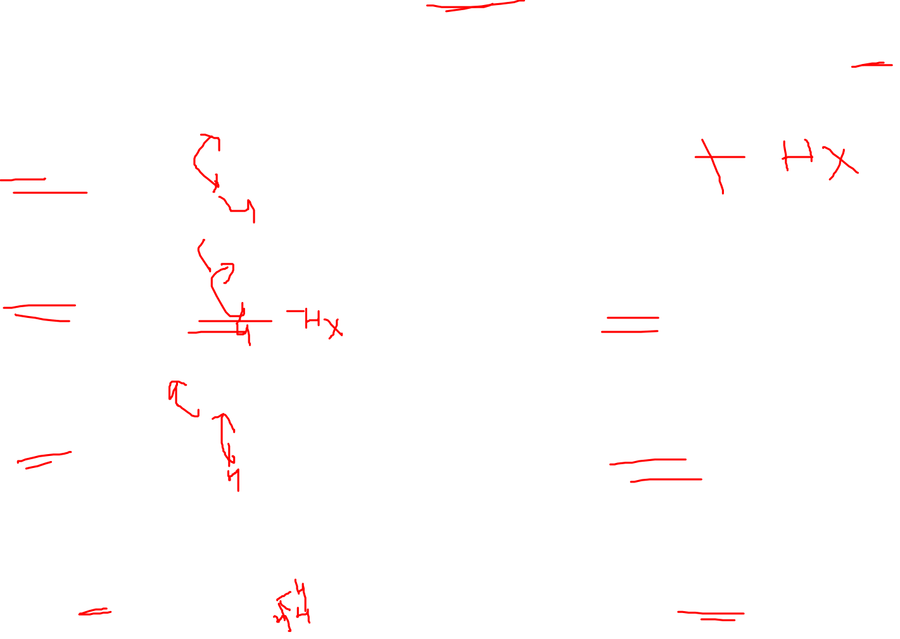
Elimination of a Proton
The carbocation may eliminate a proton or another electrophile from the adjacent atom (known as E1) to yield a stable compound.

Slide 13

Rearrangements of Carbocations
Carbocations can be stabilized by the migration of hydrogen, alkyl, or aryl groups. Both stereochemistry and migratory aptitude can be factors in determining the extent of migration of the different groups.

Slide 14

Rearrangements of Carbocations
In alicyclic systems, the relief of strain can provide a powerful driving force for rearrangement. The classical examples are the transformation of camphenilol into santene and camphene hydrochloride into isobornyl chloride. Isobornyl chloride the exo-isomer (i.e., chlorine atom on the side opposite to the migrating bridge) is the sole product, which slowly rearranges to the thermodynamically more stable endo-isomer (bornyl chloride). Bornyl chloride is also obtained by treatment of α-pinene with HCl. The strained four-membered ring in the carbocation expands to the less strained five-member analog, despite the fact that the former contains a tertiary and the latter a secondary carbocation.

Slide 15

Pinacol rearrangement
When pinacol (1,2- diols) is treated with, dilute or moderately conc. H2S04 ( for acid catalyzed dehydration), a rearrangement reaction takes place which leads to the formation of ketone called pinacolone; and the rearrangement is known as pinacol - pinacolone rearrangement.
Of the two OH groups, the one which forms the more stable carbocation is protonated preferentially. This factor takes precedence over the migratory aptitude factor. Further evidence for carbenium ion formation in the pinacol rearrangement has been obtained by oxygen-exchange experiments. Partial rearrangement of pinacol to pinacolone has been carried out in acidic solutions containing H2O18.
Migratory aptitude:
3°alkyl>cyclohexyl>2°alkyl>benzyl>phenyl>1°alkyl>CH3>>H
Beckmann Rearrangement
Fries Rearrangement
Semi- Pinacol Rearrangement
Fries Rearrangement

Slide 16

Carbanion
A carbanion is an anion in which carbon has an unshared pair of electrons and bears a negative charge usually with three substituent’s for a total of eight valence electrons.
In 1984 Olmstead presented that Addition of n-butyllithium to triphenylmethane in THF at low temperatures followed by 12-crown-4 resulted in a red solution and the salt complex precipitated at −20 ◦C
Carbanion is a unit that contains a negative charge on a carbon atom, and is therefore a base/nucleophile depending upon the reaction conditions. Carbanions are powerful Bronsted bases because their conjugate acids are extremely weak acids. Carbanion bears a formal charge of -1.

Slide 17
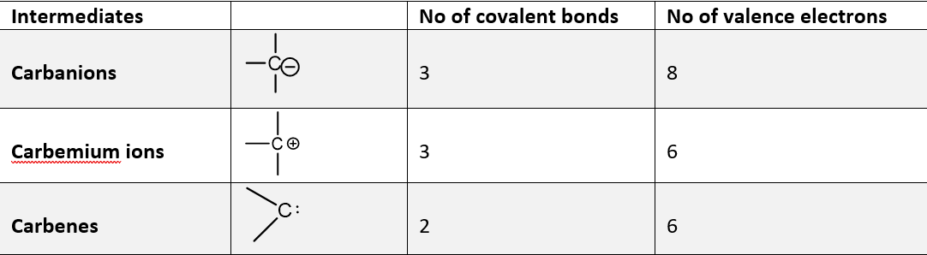
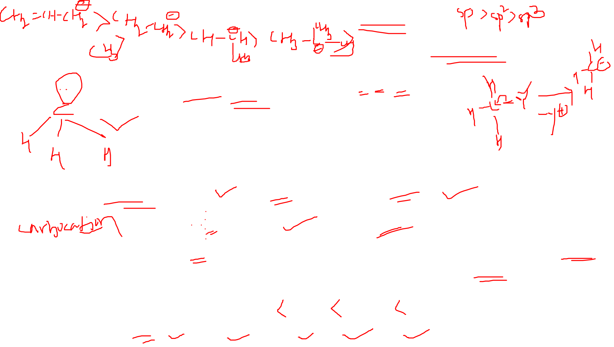
Stability of carbanion
The inductive effect of the electronegative atoms adjacent to the charge will stabilize the charge
Resonance effects can stabilize the anion. This is especially true when the anion is stabilized as a result of aromaticity. Carbanions increase in stability with an increase in the amount of s character at the carbanionic carbon. Thus the order of stability is:
The order of stability in carbanions is as follows;

Slide 18

Generation of Carbanion
Reduction of C–X Bond with Metal.
Deprotonation from a C–H Bond.
Reaction of a Metal with an Alkenes , In some cases metals will react directly with alkenes, and alkenes sometimes form carbanions by addition of nucleophiles
A Negative Ion Adds to a Carbon–Carbon Double or Triple Bond. The negative charge on a carbanion is stabilized by neighboring electron withdrawing groups such as carbonyl, nitro, cyano, and sulfone.

Slide 19

Reaction of carbanion
A carbanion may act as base or nucleophile depending on the reaction conditions.
base strength: C2H5O− > OH− > CN− > Cl−.
nucleophilic reactivity: CN− > C2H5O− > OH− > Cl−.
Enolate Reactions with Carbonyl Groups: carbanions (as enolates) undergoing nucleophilic addition to carbon–oxygen double bonds. (Examples- The aldol reaction, Claisen reaction, Dieckmann reaction, Michael reaction, and Knoevenagel condensation).

Slide 20
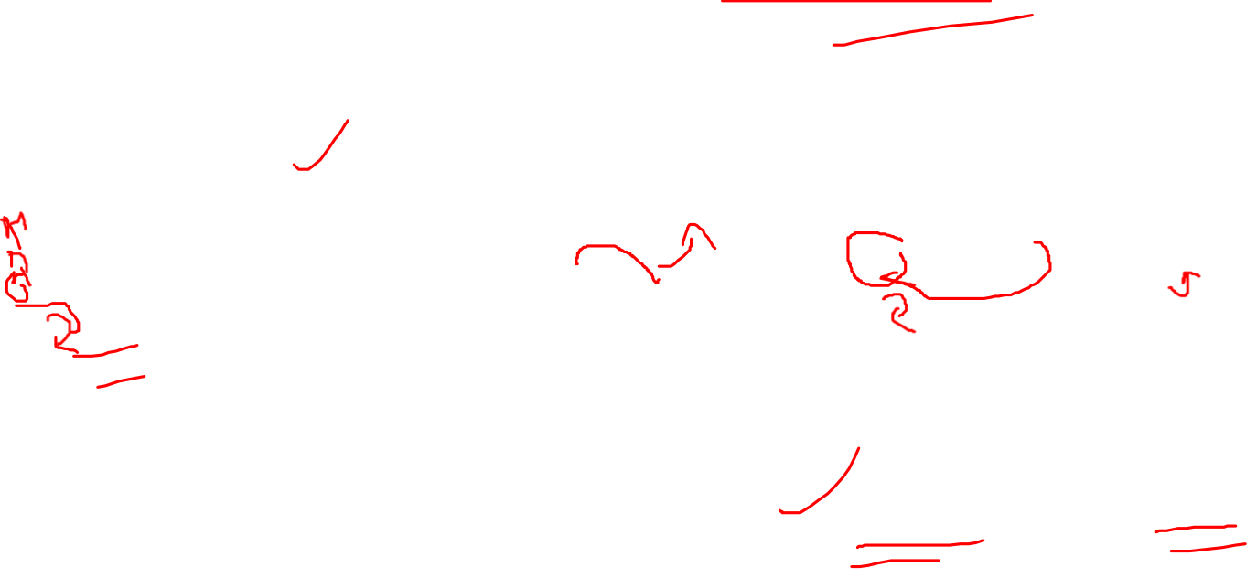
Rearrangements of Carbanions

Slide 21

Rearrangements of Carbanions

